Slide 1
Registering for
SAM 2013
Baylor University
(Institution Key:T2031171)

Slide 2
Initial Set Up
Welcome to SAM 2013! Before getting started, ensure that you are connected to the Internet.
Launch your web browser (Internet Explorer, Firefox, Safari).
Enter the URL http://sam.cengage.com to visit the SAM login page.

Slide 3
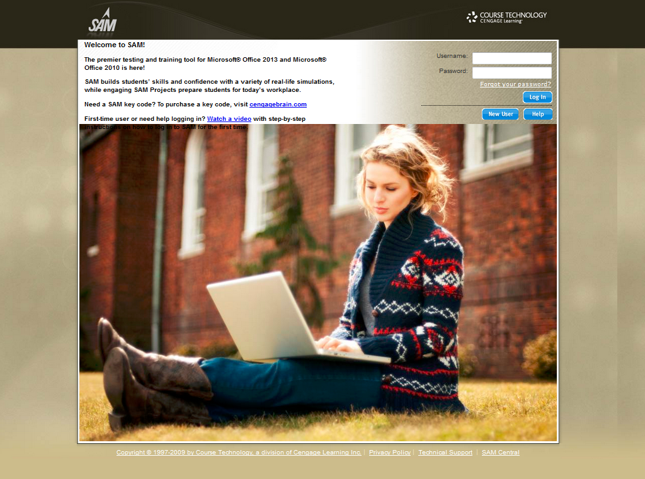
Logging into SAM 2013
For new SAM 2013 users:
Click the New User button and follow the on-screen prompts to create your SAM 2013 account.
New users can also click on Watch a video to see step-by-step instructions for creating a SAM account.
For existing SAM 2013 users: Enter your username and password, then click the
Login button.

Slide 4
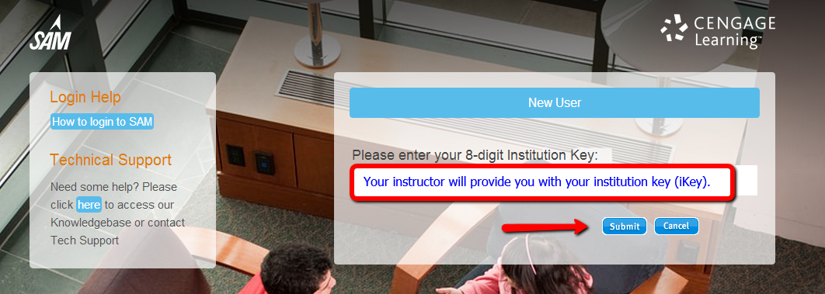
Institution Key
Enter the Institution Key provided by your instructor. It will contain 8 digits in the form of T2031171 (Baylor University).
Click Submit. If the institution in the confirmation pop-up window is correct, click OK. If the correct institution name does not appear, click Cancel and enter the correct code.

Slide 5
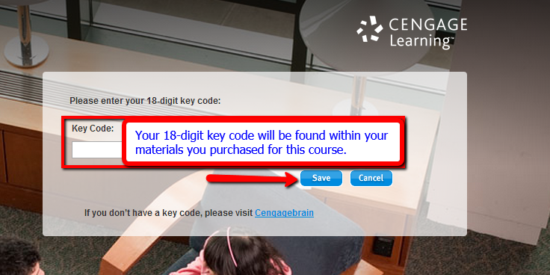
Enter your SAM Key Code
If prompted, enter your 18-digit Key Code, then click Save.
If you’ve purchased SAM from CengageBrain/microsite, enter your Instant Access code here.
If you’ve purchased a SAM 2013 Printed Access Card, your access code can be found on the inside flap. Key Codes are case-sensitive.

Slide 6
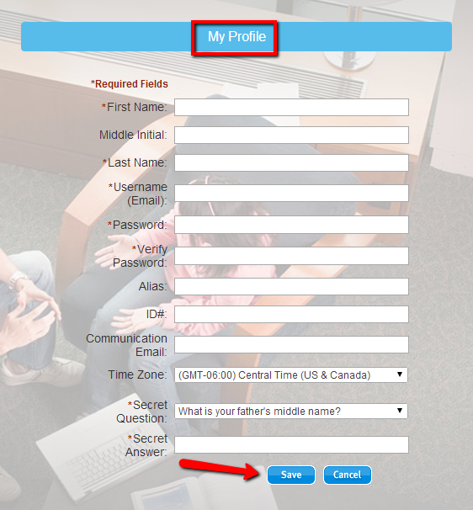
Create a SAM User Profile
You are now ready to set up your SAM 2013 User Account.
Fill in all required fields marked by a red asterisk.
Your username must be a valid email address. Note that your username cannot be changed once it has been created.
Include a secret question and answer that can be used to retrieve your password.
Click Save.

Slide 7
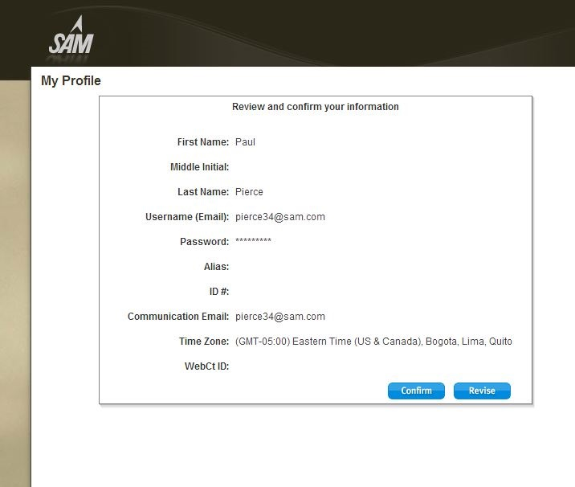
Profile Confirmation
Review and confirm the information entered is correct, then click Confirm.
If the information is not correct, click Revise to return to the prior screen.

Slide 8
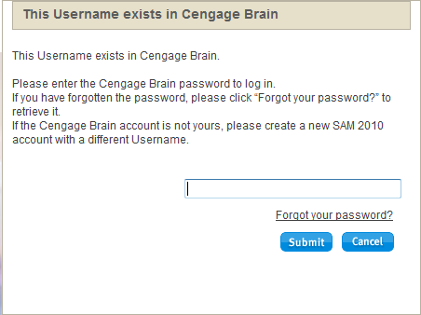
Profile Confirmation
If you have entered a Username that already exists in Cengage Brain, you will be prompted to confirm your password.
If you are unable to retrieve your password by using the “Forgot your password?” link, you will need to create a new account for SAM 2013 using a different username.

Slide 9
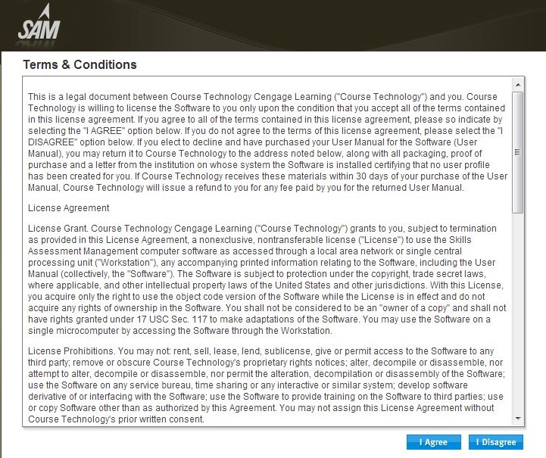
Terms & Conditions
Read the SAM Terms & Conditions, then click the I Agree button to accept and continue.
If you click the I Disagree button, SAM will automatically exit.

Slide 10
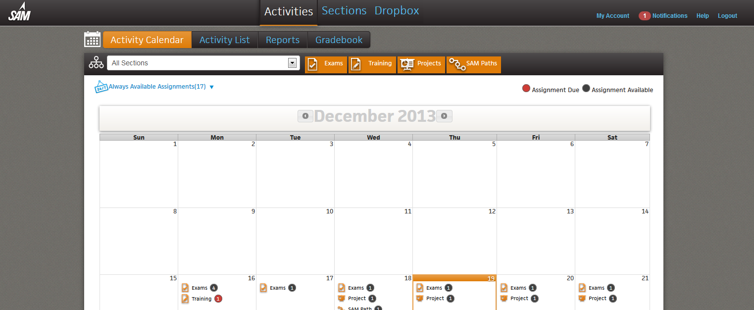
SAM 2013 Homepage
You should now see the SAM Homepage, where you will begin each SAM session.
From this screen you will be able to access your SAM Assignments, Reports, Dropbox, Join a Section, See up to date SAM Notifications and more.

Slide 11
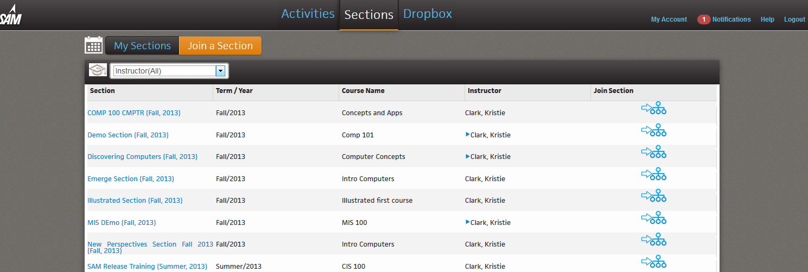
Join a Section
To access your course Assignments in SAM, you must be enrolled in a Section.
Once enrolled, you will then see your assignments populate on your homepage Calendar.

Slide 12
Join a Section
To Join a Section:
1. Click Sections on the navigation bar on the homepage.
2. This will take you to the My Sections page, where you can view your status in a section or join a new section by clicking the Join a Section button.
3. From here find your Instructor in by selecting them from the dropdown box. Now you will see all of their available sections
4. Once you find your section click the blue button under the Join Section column.
You will then see a pop out that will tell you if your enrollment was accepted.
Depending on how your Section has been set up, your enrollment may need to be confirmed by the instructor.

Slide 13
My SAM Assignments
On your homepage the SAM Calendar will show you your daily assignments
You can change this view by clicking on the navigation bar (highlighted by the green arrow).
You can filter what Assignments appear on the calendar by turning on and off the filters (highlighted by the blue arrow).
View SAM updates and notifications by clicking on the Notifications icon in the upper right hand side of the page.
To launch an Assignment, click on SAM Assignments on the navigation bar, then click the Assignment link.

Slide 14
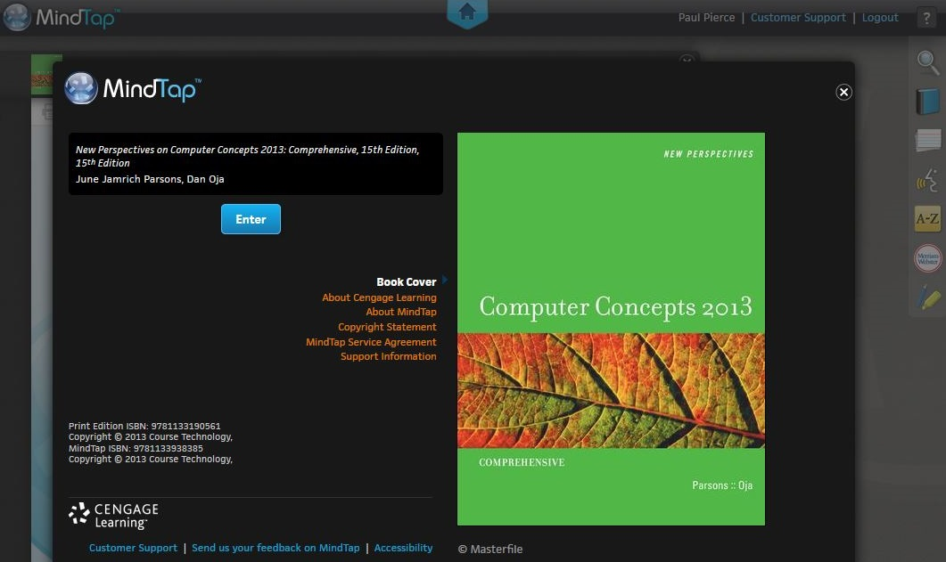
Access MindTap Reader
If your SAM 2013 account includes access to a MindTap Reader, review the following steps to launch it.
From your Calendar Click on Always Available Assignments.
Click on the MindTap Reader title to launch your MindTap Reader within SAM.
**Note: Your browser’s pop-up blockers must be turned off to view the e-book.

Slide 15
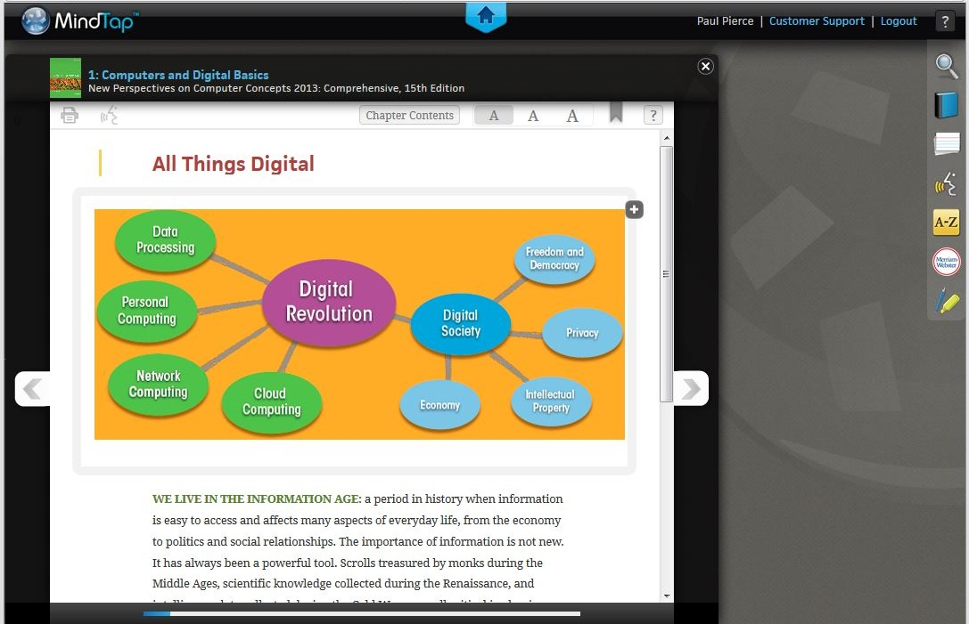
Access MindTap Reader
MindTap Reader gives you full access to your reading assignments, as well as:
Flashcards
Search
Dictionary
Glossary
ReadSpeaker
Highlighter
Notepad/Evernote
Embedded videos

Slide 16
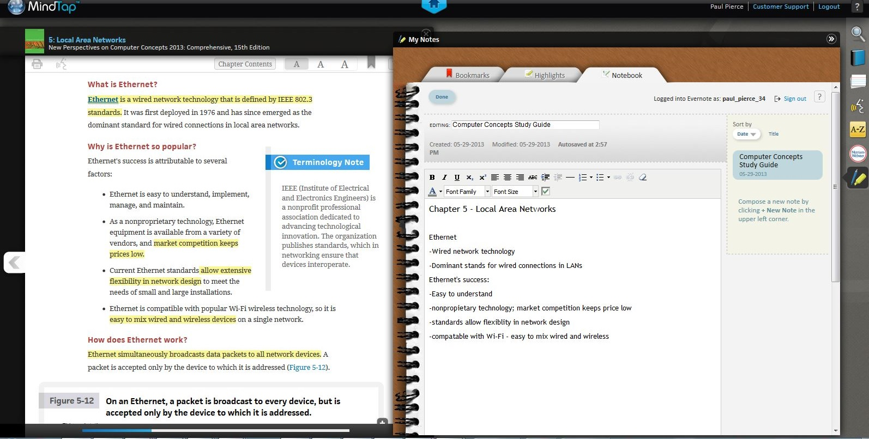
Access MindTap Reader
MindTap gives you flexibility to access readings within SAM in a web browser or on a tablet. Integrated Highlighting and Notes tabs allow you to create your own study guide as you read, while the ReadSpeaker feature reads chapter text aloud for you!

Slide 17
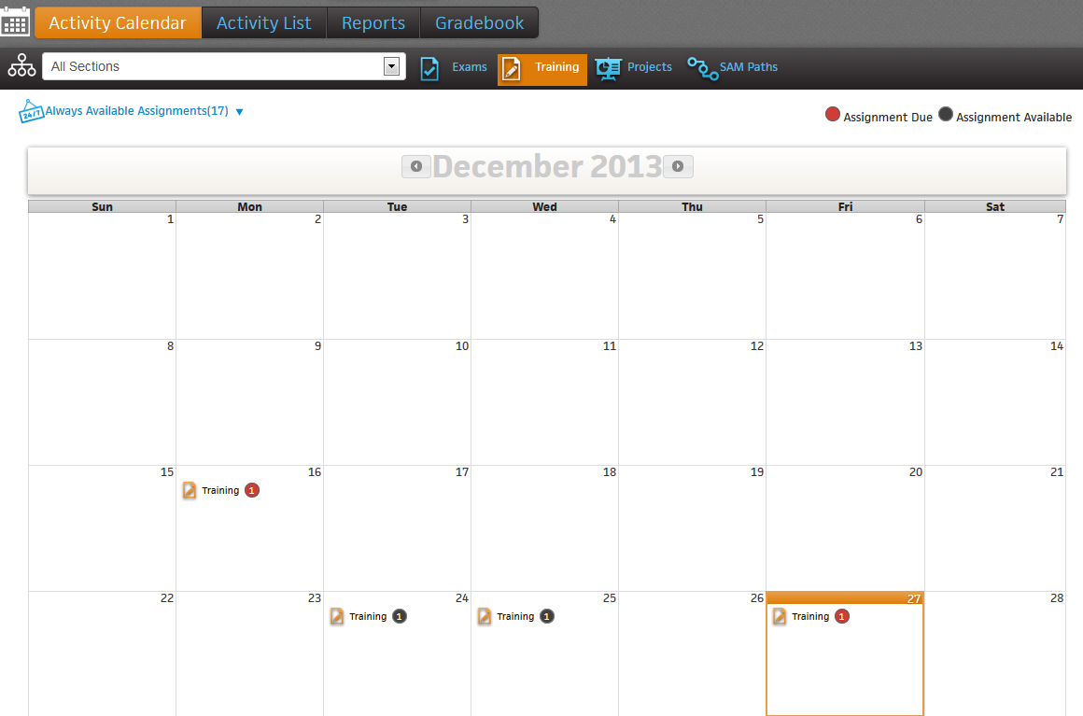
SAM 2013 Training
SAM 2013 offers simulated Trainings focused in Microsoft Office, Windows, Internet Explorer and Computer Concepts
To launch a SAM Training, begin on your Homepage Calendar adjust the filters to leave only the Trainings highlighted.
Click the Training you would like to view on the Calendar.
To begin a Training click the name of the individual Training (for example “DC Chapter 2 The Internet Training”)
You will then see a pop out where you will then click Start to begin

Slide 18
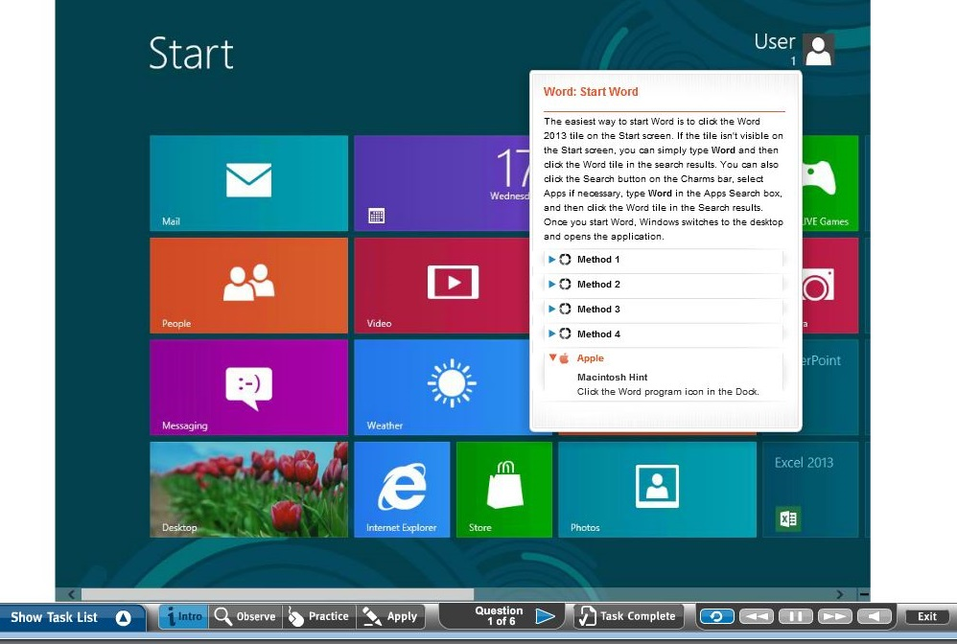
SAM 2013 Training-Office
The Training landing screen takes you to the Intro mode, which provides a written description of the task, alternative methods to complete the task, and hints for completing the task using a Mac.

Slide 19
SAM 2013 Training-Office
SAM offers 3 training methods to help you master Microsoft Office, Windows, and Internet Explorer.
Observe: Provides audio and visual instructions.
Practice: Helps you perform the task using audio and visual prompts.
Apply: Allows you to perform the task on your own.
To receive credit on a Training task, you must complete the task in the Apply mode and click the Task Complete button.

Slide 20
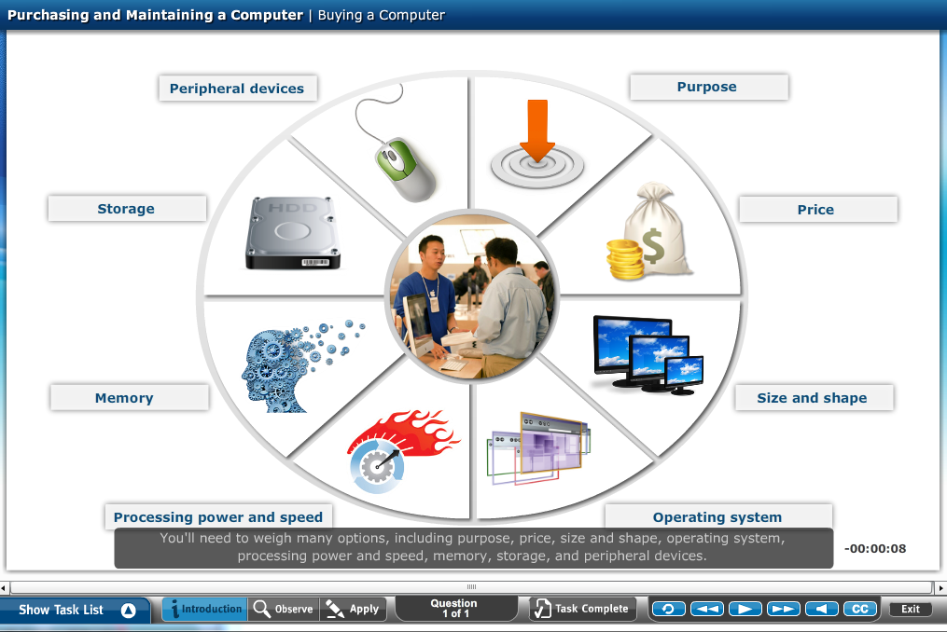
SAM 2013 Training-Concepts
SAM 2013 also helps you master important Computer Concepts with over 800 minutes of audio-visual Training labs.
Introduction: Provides a contextual overview of the topics covered in each Training lab.
Observe: Provides audio and visual instruction for Computer Concepts topics. Note: Closed captioning is available for both Introduction and Observe modes.
Apply: Apply the concepts you’ve learned in the training lab with interactive reinforcement such as Drag and Drop and Matching activities.

Slide 21
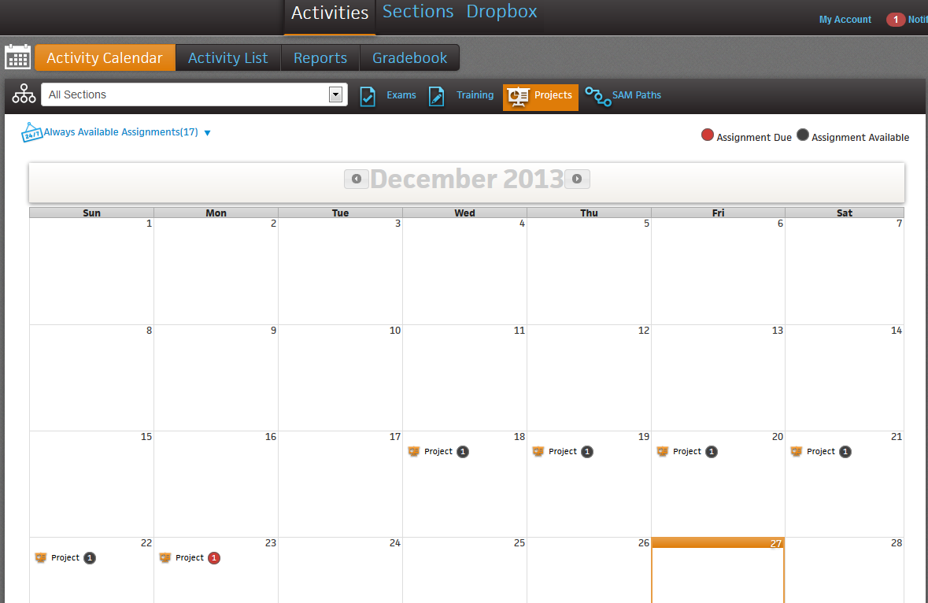
SAM 2013 Projects
With SAM Projects, you work directly in Microsoft Office 2013 to complete a real-world project using step-by-step instructions.
To launch a SAM Project, begin on your Homepage Calendar adjust the filters to leave only the Projects highlighted.
Click the Project you would like to view on the Calendar.
To begin a Project click the name of the individual Project (for example “SC Excel CH1 Project”)
You will then see a pop out where you will then click Start to begin

Slide 22
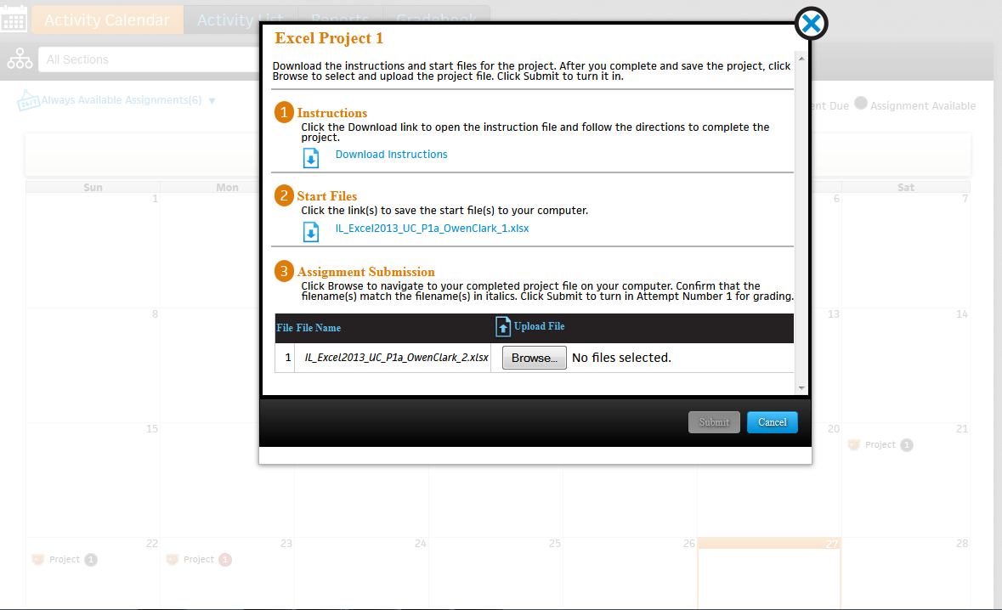
SAM 2013 Projects
After launching a Project, download and save the Instructions, personalized Start file, and any support files (if available) to your computer, USB drive, or another location.

Slide 23
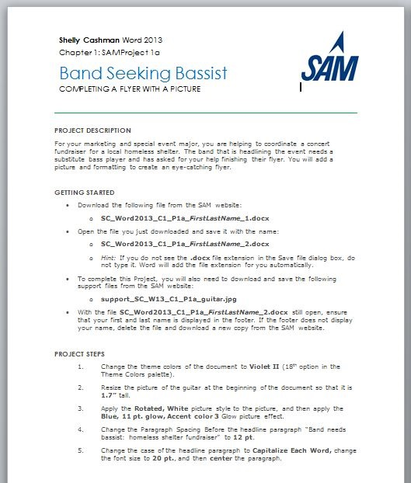
Sample Instruction File
The Project Instruction file contains:
Project Description, a real-world case scenario.
Getting Started section, including important information for saving your Project files.
Project Steps to complete the Project.
Final Figure to refer to while completing the Project.

Slide 24
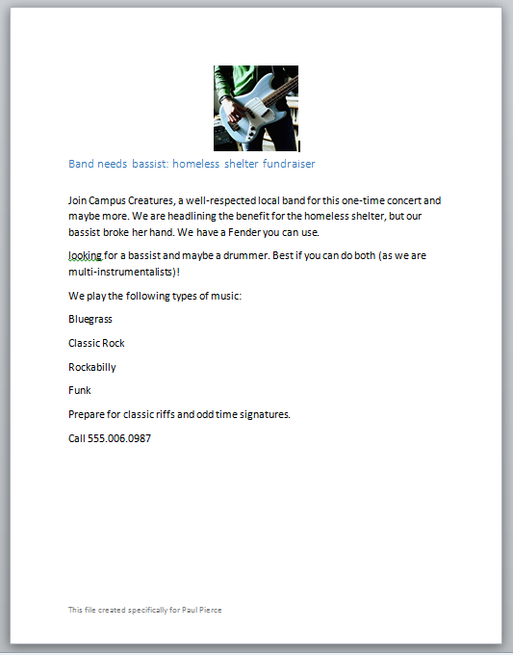
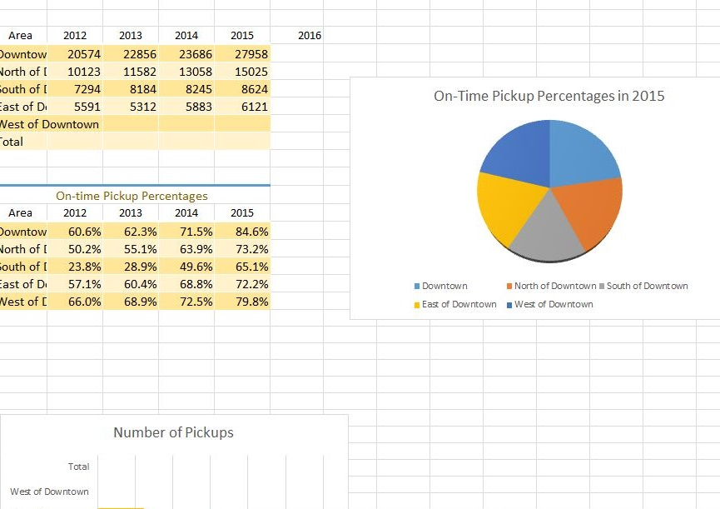
Sample Start Files
Complete all Project work using your personalized Start file, which has your name encrypted in it.
Be sure to follow all of the Project Step instructions and to save your completed file before submitting it for grading.

Slide 25
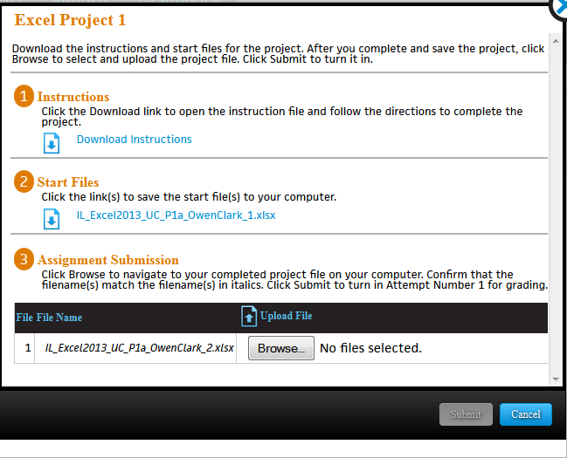
Submit for Grading
When you’ve completed your Project, revisit the SAM site.
Under Assignment Submission, click Browse to select your saved Project file, then click Submit.
You will see a screen that confirms your Project has been uploaded and meets the correct virus scan requirements, file size, and format.

Slide 26
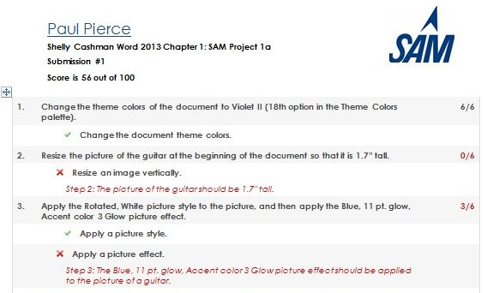
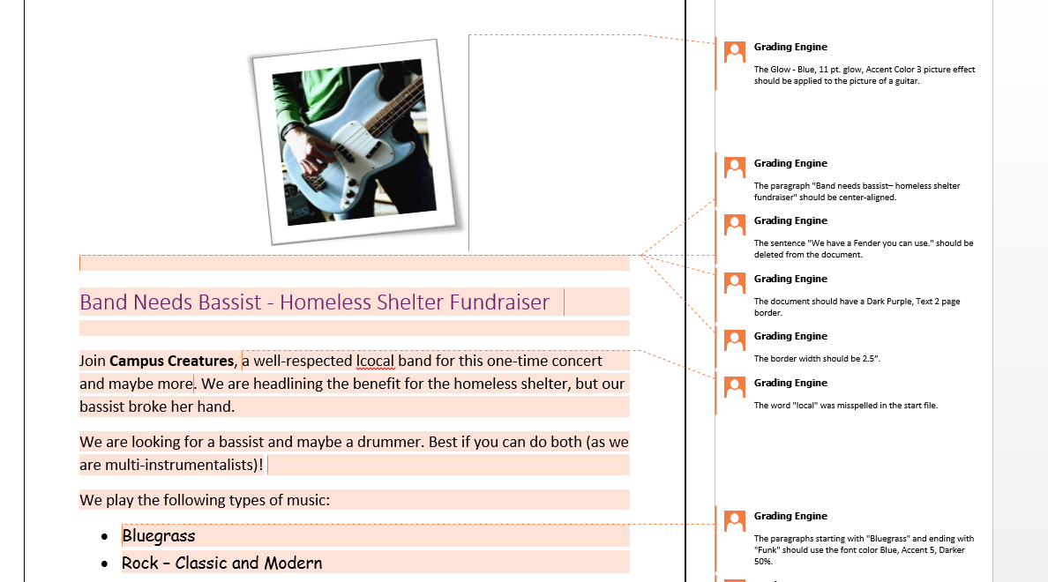
Graded File Summary
After submitting your Project, view your grade and generate a Project Study Guide by clicking Results on the navigation bar.
Select Project from the Report Type dropdown and Download Submitted Projects from the Report dropdown.
Click the Download link next to the Project name to download your Graded Summary Report.
This report provides detailed comments explaining why point deductions were made, as well as call-outs inserted directly into your submitted Project to help you pinpoint and correct errors.

Slide 27
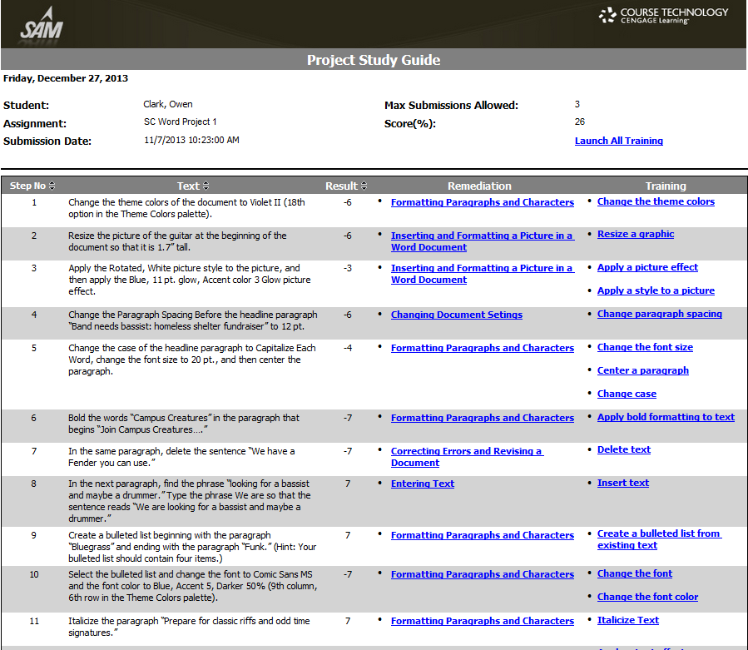
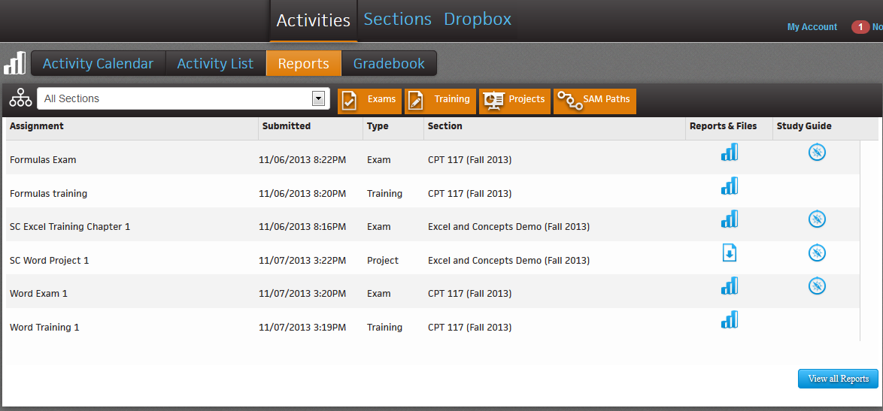
Project Study Guide
From the Reports tab, you can also generate a Project Study Guide.
Items with Study Guides available have an icon in the Study Guide column
The Study Guide lists each step in the project with remediation that refers to the pages in your textbook or MindTap Reader, along with links to SAM Training tasks.

Slide 28
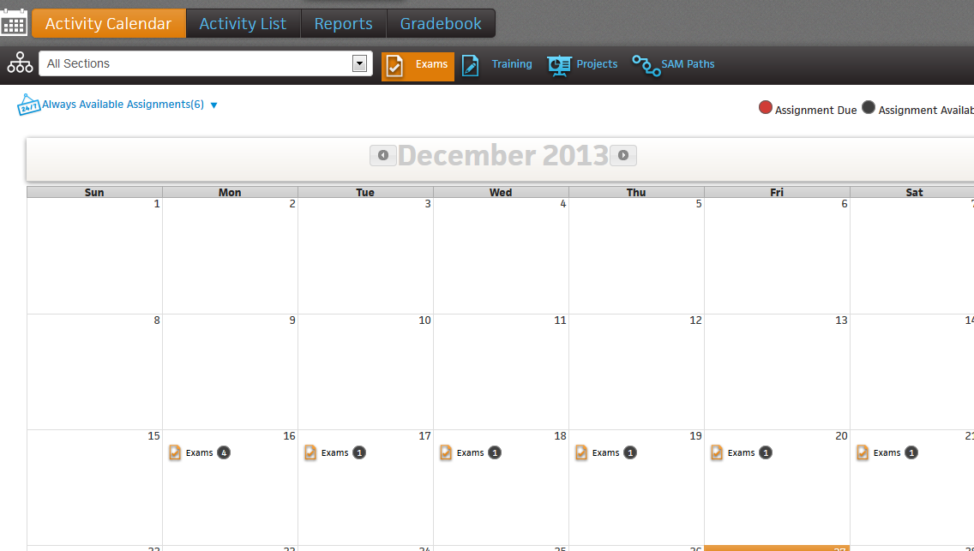
SAM 2013 Exams
To launch a SAM Exam, begin on your Homepage Calendar adjust the filters to leave only the Exams highlighted.
Click the Exam you would like to view on the Calendar.
To begin a Exam click the name of the individual Project (for example “DC chapter 3 Mobile Devices Exam”)
Review your Exam details, which may include:
Instructions
Time limit
Number of chances at each question
Number of retakes of entire exam
You will then see a pop out where you will then click Start to begin

Slide 29
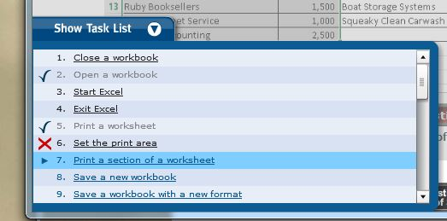
SAM 2013 Exams
6
Task List. Use this list to jump from task to task.
Task ID number.
Question Label. Back and forward arrows allow you to jump between tasks.
5
1
4
7
2
3
4. Time remaining (if set by instructor), and number of attempts remaining per question.
5. Description of the task you must perform.
Simulation of the application where you will complete the task.
Exit button. Once you start the exam, you cannot exit without scoring your exam performance.

Slide 30
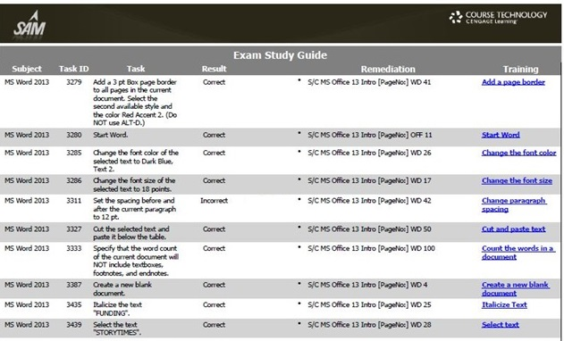
Exam Study Guide
To access your Exam results and Study Guide, click on Reports on the navigation tab. Deselect all filters except Exam
Items with Study Guides available have an icon in the Study Guide column
You can launch Training tasks directly from the links in the Study Guide.

Slide 31
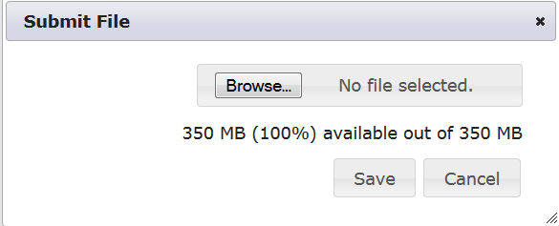
Dropbox
To access Dropbox, click on the Dropbox button on the navigation tab.
On the landing screen of the Dropbox page, select your Section from the dropdown menu; click OK.
To submit a file in Dropbox, click on the Submit New File button.
In the resulting window, click on the Browse button to select the desired file.
Click Save to submit your file.

Slide 32
Gradebook
To access the Gradebook, click on Gradbeook on the Navigation bar. Select your section from the dropdown. Click OK.
Each type of Assignment (Exam, Project, Training) is listed with assignment weights and your score.
The number located in the parenthesis next to the assignment type indicates the number of assignments in that category. Click “+” to expand your view and see how you did on individual assignments.

Slide 33
Questions?
Cengage offers “Getting Started with SAM” online training sessions to help you:
Create your user profile
Join a Section
Complete your assignments
Run reports
You can use the following link to browse and register for upcoming sessions: http://www.cengage.com/training/students/sam
For general SAM assistance, please visit www.cengage.com/support

